Slide 1
Python reinforcement project
Airlines data analysis
BY
-JAWEED

Slide 2
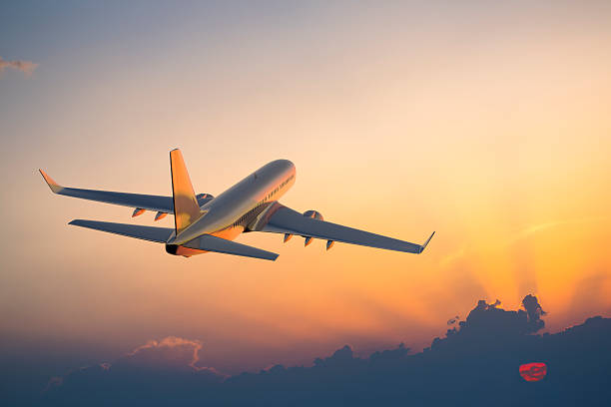
Introduction
THE AIRLINES DATASET
The Flights Booking Dataset of various Airlines is a scraped datewise from a famous website in a structured format. The dataset contains the records of flight travel details between the cities in India. Here, multiple features are present like Source & Destination City, Arrival & Departure Time, Duration & Price of the flight etc.
This data is available as a CSV file. We are going to analyze this data set using the Pandas DataFrame.
This analyse will be helpful for those working in Airlines, Travel domain.

Slide 3
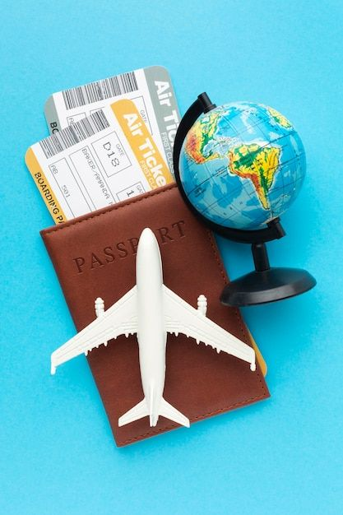
GOAL OF THE PROJECT
The goal of this project is to analyze airline data to understand flight price patterns and booking trends.
It aims to identify key factors such as airline, class, duration, stops, and days left that affect ticket prices.
Additionally, the project focuses on visualizing insights and predicting flight prices using machine learning.
DATASET DESCRIPTIVE
Dataset collected from airline records (e.g., Kaggle).
Contains flight details such as airline, flight number, airports, timings.
Covers data across a specific time period.
Provides foundation for analyzing performance & passenger trends.
Includes delay and cancellation information.

Slide 4
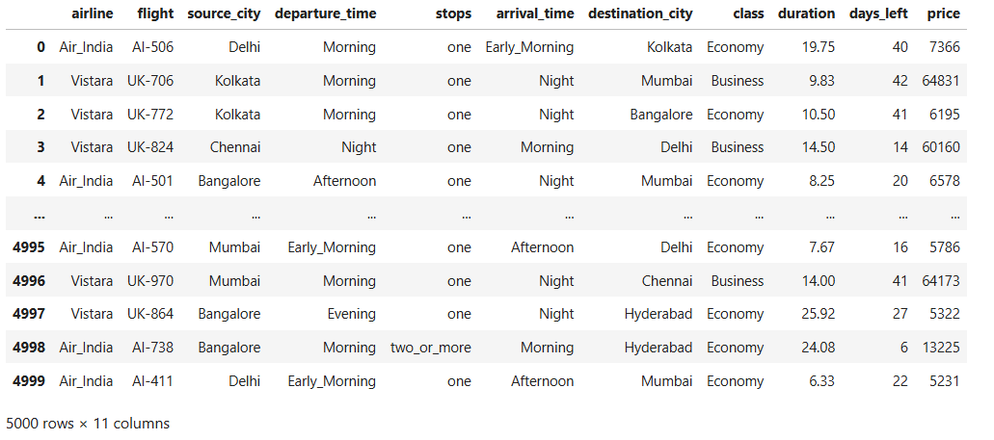
DATASET OVERVIEW

Slide 5
DATA CLEANING
MISSING VALUES
OUTLIERS TREATMENT
Checked for missing values across all columns.
Outliers were detected in the Price column using boxplots. Some tickets were extremely high compared to the rest.
Columns such as Airline, Source, Destination, Duration, Stops, Class, and Days Left did not contain significant missing values.
Since these could represent rare but valid cases (e.g., last-minute business class tickets), outliers were not removed but flagged for analysis
For any small gaps in Duration or Price, appropriate imputation was applied (mean/median replacement).
Flight duration also showed rare extreme values, which were carefully review

Slide 6
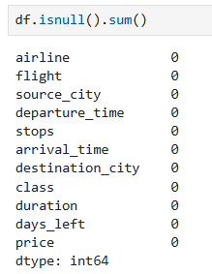

MISSING VALUES
THE DATASET CONTAINS NO NULL VALUES ENSURING CLEAN AND RELIABLE ANALYSIS WITHOUT THE NEED FOR IMPUTATION OR DATA CLEANING.
DROP COLUMNS
REMOVING THE INDEX COLUMN
IT IS NOT USEFUL FOR ANALYSIS.
IT ONLY ADDS EXTRA NOISE TO THE DATASET.
REMOVING IT MAKES THE DATA CLEAN AND CLEAR.

Slide 7
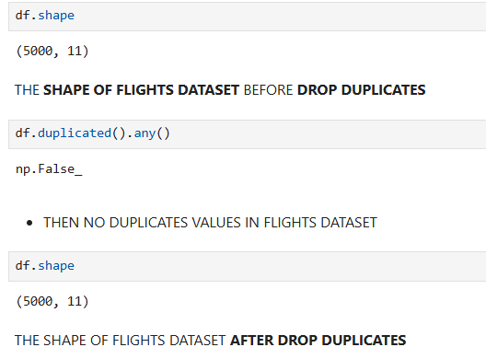
DROP DUPLICATES

Slide 8
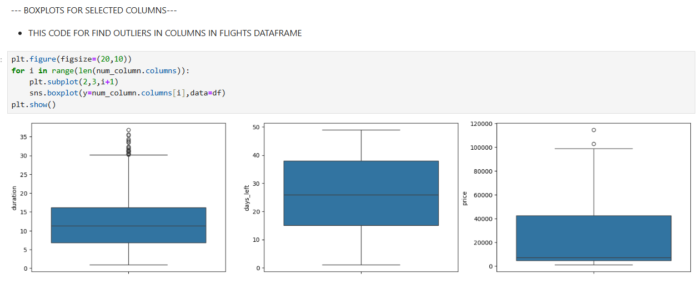
OUTLIERS TREATMENT
The above the two charts which duration , price have outliers.
High prices (Business class, last-minute) and long durations (connecting flights) are expected.
when we remove the outliers means its affect analysis results

Slide 9
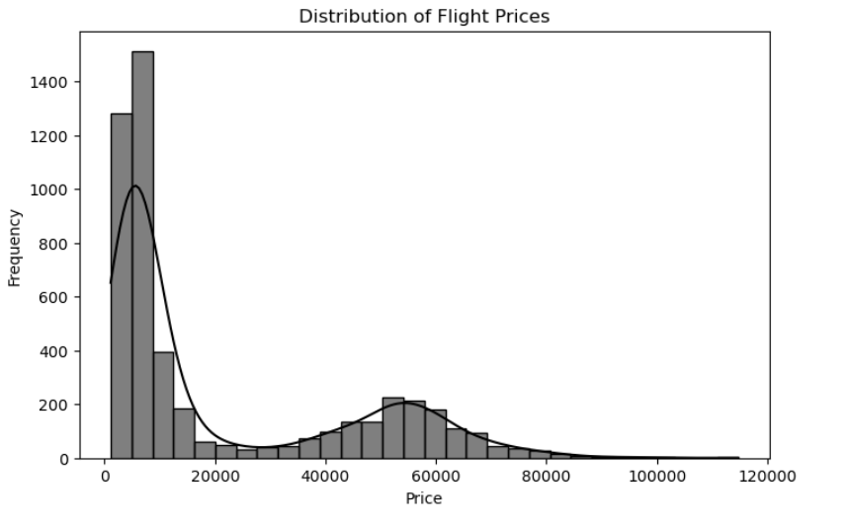
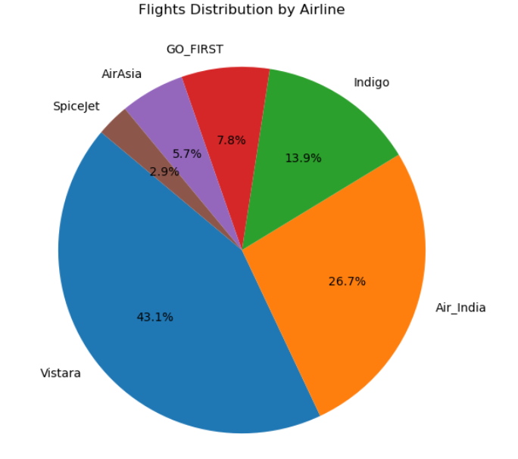
EXPLORATORY DATA ANALYSIS
1.UNIVARIATE ANALYSIS
HISTOGRAM PLOT
PIE CHART
DISTRIBUTION OF FLIGHT PRICES
FLIGHTS DISTRIBUTION BY AIRLINE

Slide 10
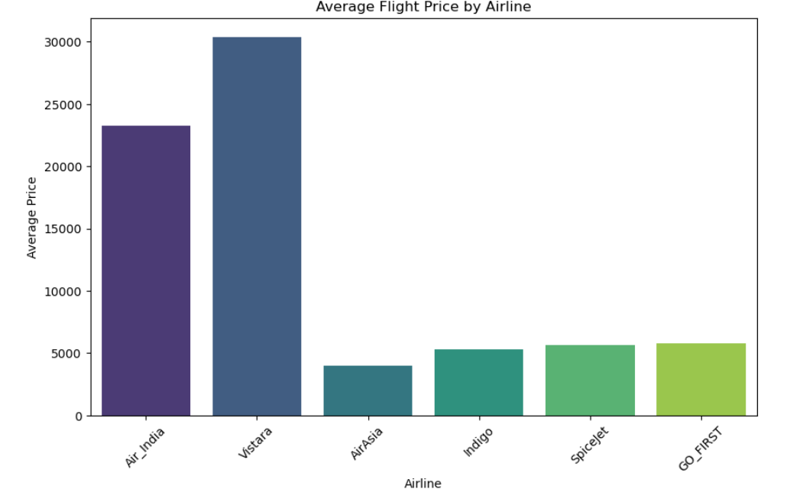
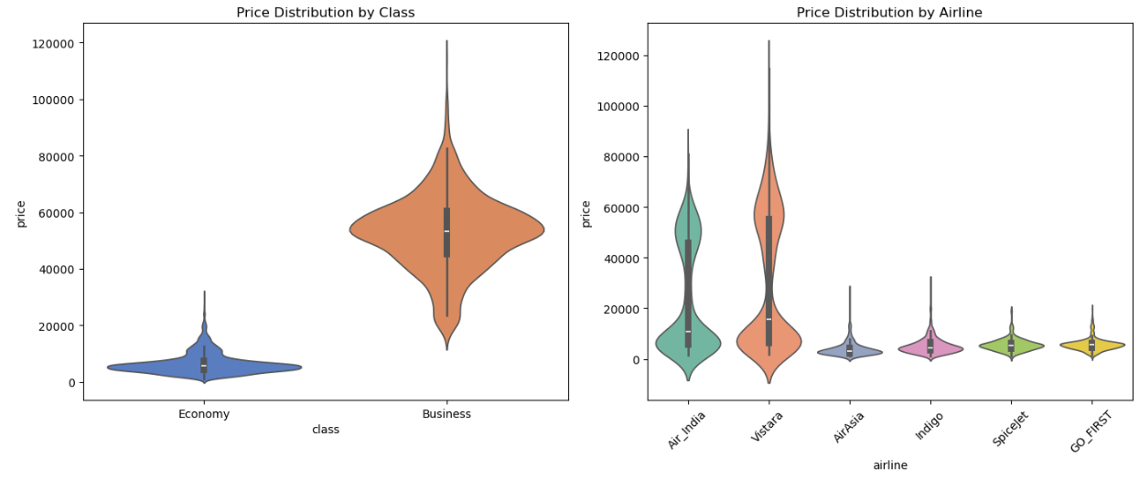
2. BIVARIATE ANALYSIS
BAR PLOT
VIOLIN PLOT
AVERAGE FLIGHT PRICE BY AIRLINE
PRICE DISTRIBUTION OF CLASS AND AIRLINES

Slide 11
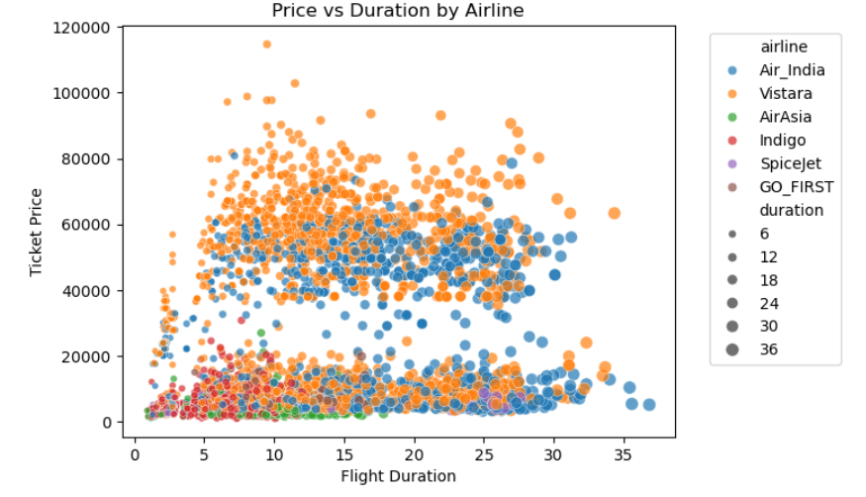
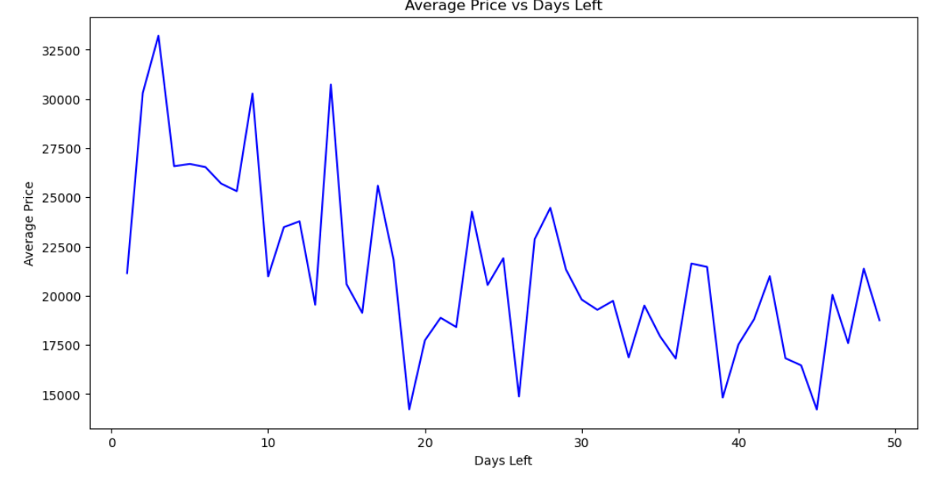
SCATTER PLOT
LINE PLOT
AVERAGE PRICE VS DAY LEFT
PRICE VS DURATION BY AIRLINES

Slide 12
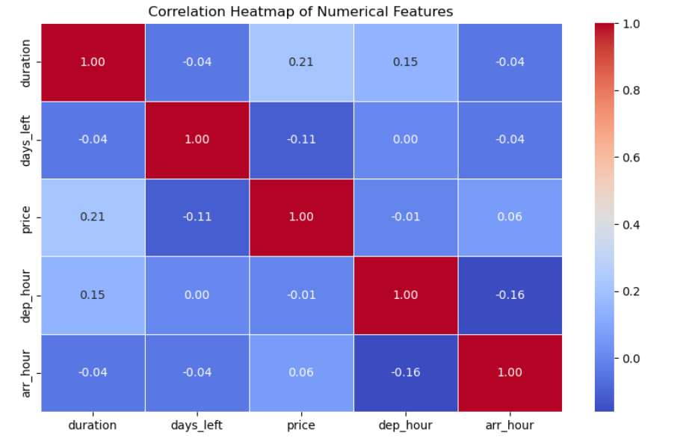
3.MULTIVARIATE ANALYSIS
HEAT MAP
Price vs Duration shows a weak positive relation, meaning longer flights are usually a bit costlier.
Price vs Days_Left has a weak negative relation, showing last-minute bookings tend to be slightly more expensive.
No strong correlations exist among features, meaning each factor (price, time, duration) affects flights mostly independently.

Slide 13
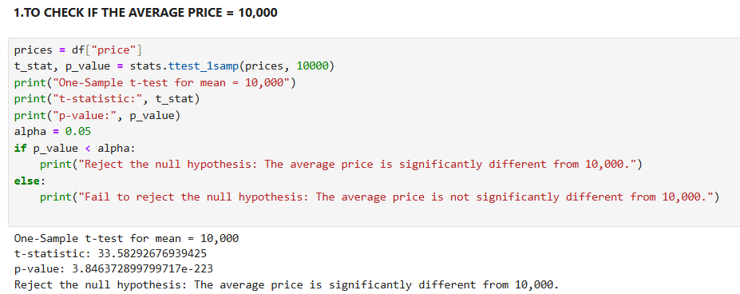
HYPOTHESIS TESTING
1.ONE SAMPLE T-TEST FOR AVERAGE PRICE

Slide 14
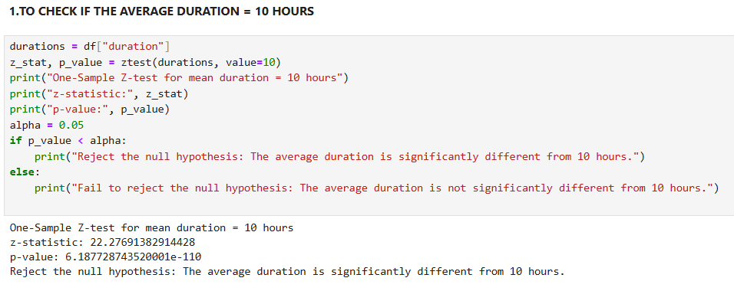
2.ONE SAMPLE Z-TEST FOR DURATION

Slide 15
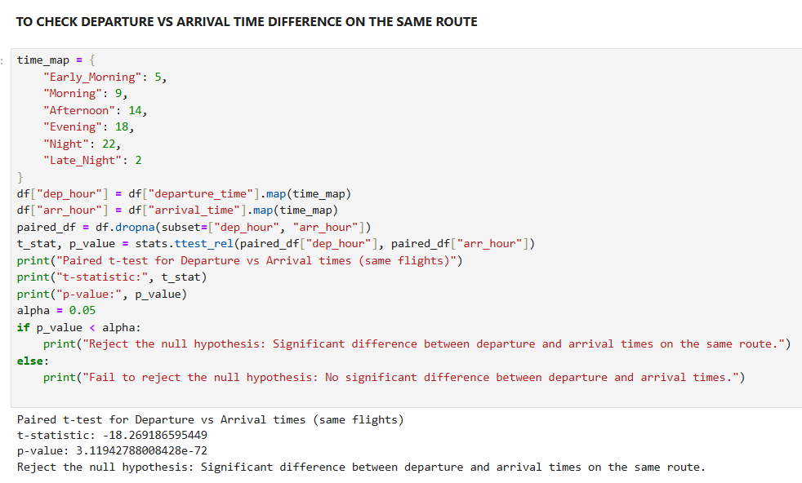
3.PAIRED TEST

Slide 16
CONCLUSION
This project highlights that airline ticket prices are influenced by multiple factors including airline type, class, stops, duration, booking window, and departure time.
Business class fares are consistently higher, while economy fares vary widely depending on booking patterns.
Non-stop flights, though costly, save travel time, whereas flights with stops are cheaper but longer.
Booking window plays the most crucial role, with last-minute tickets being very expensive and advance bookings offering the best deals.
Outliers such as high-priced last-minute business class tickets reflect dynamic pricing strategies.

Slide 17
THANK YOU

